Slide 1
Linear Algebra
Lecture 30

Slide 2
Eigenvalues and
Eigenvectors

Slide 3
Diagonalization

Slide 4
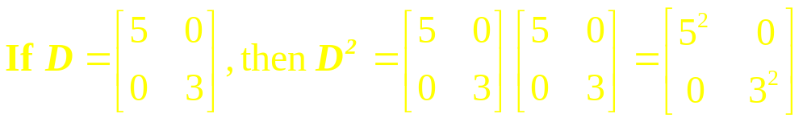
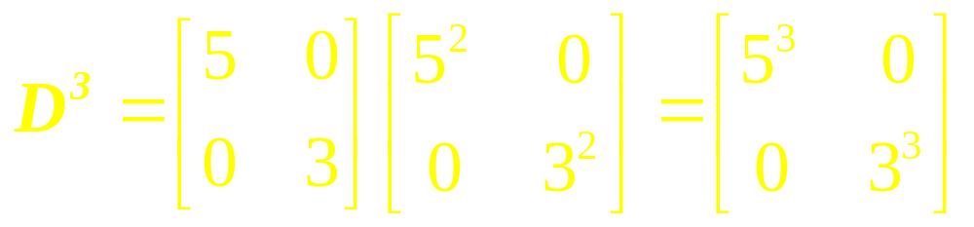
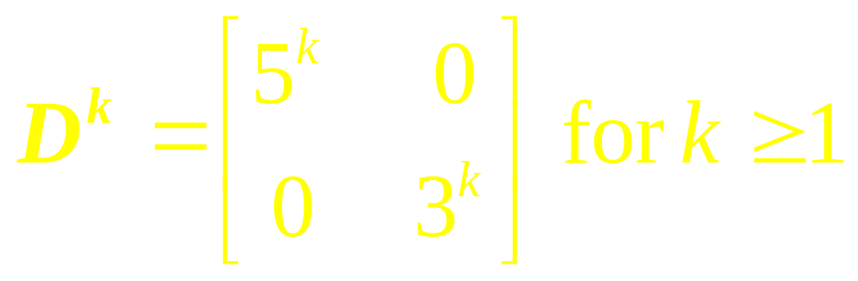
Example 1

Slide 5
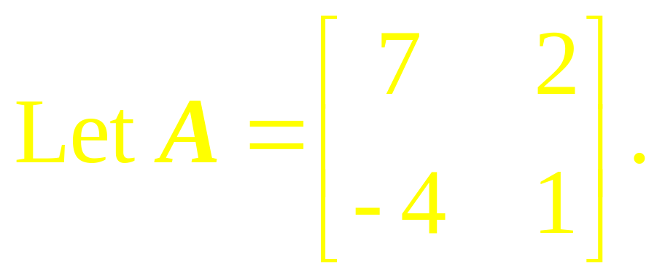
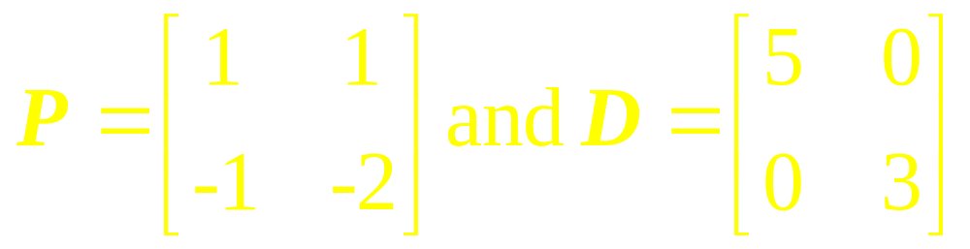
Find a formula for A^{k}, given that A = PDP ⁻¹, where
Example 2

Slide 6
Remark
A square matrix A is said to be diagonalizable if A is similar to a diagonal matrix, that is, if A = PDP ⁻¹ for some invertible matrix P and some diagonal matrix D.

Slide 7
Diagonalization Theorem
An n x n matrix A is diagonalizable if and only if A has n linearly independent eigenvectors.

Slide 8
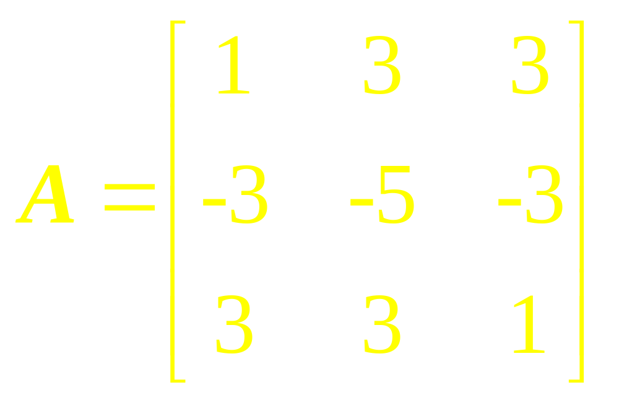
Example 3
Diagonalize the following matrix, if possible

Slide 9
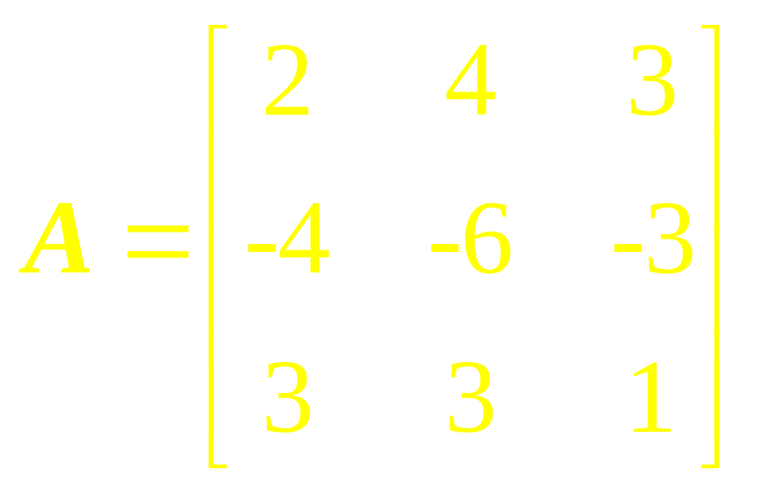
Example 4
Diagonalize the following matrix, if possible

Slide 10
Theorem
An n x n matrix with n distinct eigenvalues is diagonalizable.

Slide 11
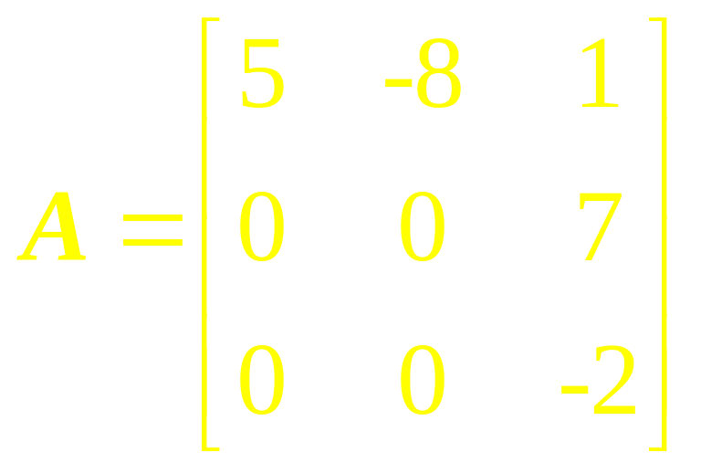
Example 5
Determine if the following matrix is diagonalizable.
…

Slide 12
Solution
Since the matrix is triangular, its eigenvalues are obviously 5, 0, and –2. Since A is a 3 x 3 matrix with three distinct eigenvalues, A is diagonalizable.

Slide 13
Theorem

Slide 14
Examples

Slide 15
Linear Algebra
Lecture 30

